Slide 1

PROJECT
PRESENTATION
CINEPLEX

Slide 2
TABLE OF CONTENTS
01
02
03
04
Introduction
-Scope
-Functional Requirements
Database Modeling
-Business rules & assumptions
-E-R Data Model
-Relational Schema
Database Design & Implementation
-Table Design and Data Integrity Control
-Table Creation
-Relational Diagram
-Sample Data
-Sample SQL Queries
Evaluation & Conclusion
-Achievement
-Further development & improvement

Slide 3
Introduction

Slide 4


Scope
The database created will support sign up, ticketing, transaction, and other functions
Customers need to sign up for Cineplex accounts before booking a ticket
Customers can choose a theater, movie, seat, date, and showtime using their Cineplex account
The transaction page will show up to complete the online booking process
Customers will input payment information to process payment and complete ticket purchase
Mobile ticket will be emailed to customer's email address after payment completion
The mobile ticket will include film name, auditorium, seat, date, and showtime information
The database will connect the booking processes for data storing and provide a smoother experience for customers.

Slide 5

Functional Requirements
Secure storing of customer data in database
User-friendly sign-up process
The ticket booking process must allow customers to select a theater, movie, seat, date, and showtime, and be able to make changes if necessary
The transaction page must be secure and reliable
The ticket should be scannable at the theater entrance to prevent fraud and ensure a smooth entry experience
The database must be scalable and able to handle a large volume of data
The website and mobile app must be regularly maintained and updated to ensure functionality and security.

Slide 6
Database Modelling

Slide 7
Business Rules & Assumptions
A customer has a customer ID, first name, last name, email address, and phone number.
A credit card includes card number, cardholder name, security code, expiry date, and billing address.
A movie has a movie ID, movie title, movie duration, and movie type.
A ticket includes ticket ID, movie title, scheduled time, seat ID, ticket price, and ticket type.
The ticket type on a ticket has three different types of tickets, including adult, student, and children.
A showing includes showing ticket ID, showing location, showing start time, showing end time, and theatre room number.

Slide 8
Business Rules & Assumptions
Each customer has its unique customer ID.
Each credit card has its unique credit card number.
Each ticket has its unique ticket ID.
Each movie has its unique movie ID.
Each showing has its unique showing ticket ID.
Notes:
Our customers each have a unique customer ID, and provide us with their first name, last name, email address, and phone number. When they purchase tickets, they can use a credit card with a unique card number, cardholder name, security code, expiry date, and billing address.
Movies are identified by a unique movie ID, and include information such as the movie title, duration, and type. Each ticket sold at Cinplex cinema has a unique ticket ID, and includes details like the movie title, scheduled time, seat ID, ticket price, and ticket type. There are three types of tickets available - adult, student, and children.
Finally, we organize showings with a unique showing ticket ID, which includes information about the location, start time, end time, and theatre room number.

Slide 9
Business Rules & Assumptions
Relationship Assumptions
A customer needs to purchase a ticket to watch a movie.
A customer can purchase one or more tickets.
A ticket can be purchased by one customer.
One credit card can be paid for multiple tickets.
Tickets have to be paid with only one credit card.
A ticket can place only one movie.
A movie with its details can be placed on one or more tickets.
A movie can be projected by one or more showings.
A showing projects only one movie at a time.
Notes:
We require customers to purchase a ticket to watch a movie, and a single customer can purchase one or more tickets. Each ticket can only be purchased by one customer, but a single credit card can be used to pay for multiple tickets.
A ticket can only be used to watch one movie, but a movie with its details can be placed on one or more tickets. Additionally, a movie can be projected by one or more showings, and each showing can only project one movie at a time.

Slide 10
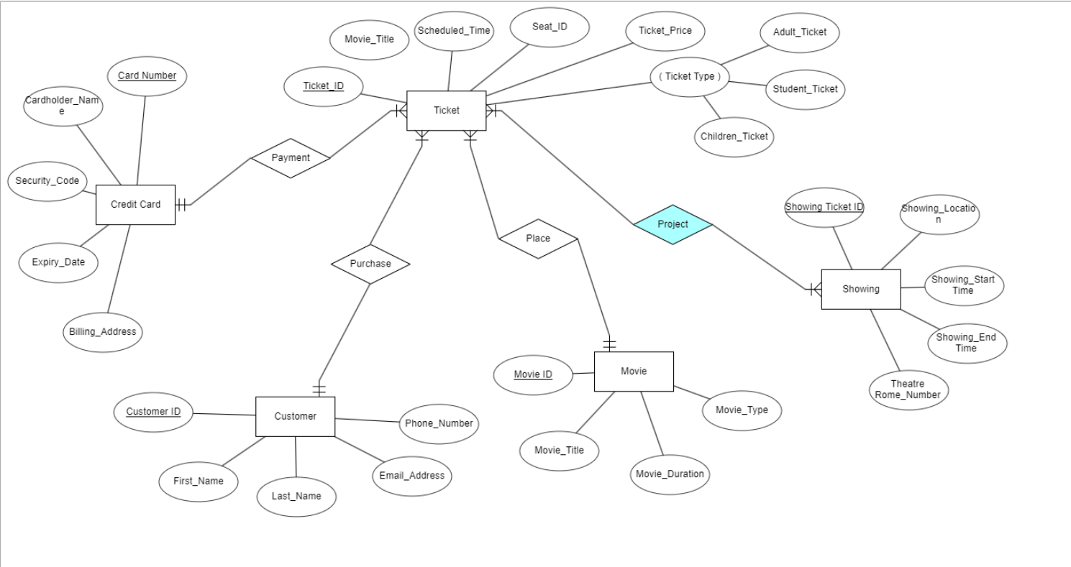
E-R Model(Edited version)

Slide 11
Database Design
& Implementation

Slide 12
Table Design & Data Integrity Control
Table Name | Column Name | Key | Data Type | Allow Nulls | Foreign Key
Customer | Customer_ID | PK | INT | NO
Movie | Movie_ID | PK | INT | NO
Credit_Card | Card_Number | PK | CHAR(16) | NO
Showing | Showing_Ticket_ID | PK | INT | NO
 | Movie_ID |  | INT | NO | FK
Ticket | Ticket_ID | PK | INT | NO
 | Customer_ID |  | INT | NO | FK
 | Movie_ID |  | INT | NO | FK
 | Card_Number |  | CHAR(16) | NO | FK

Slide 13
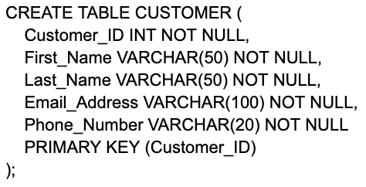
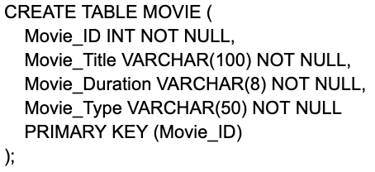
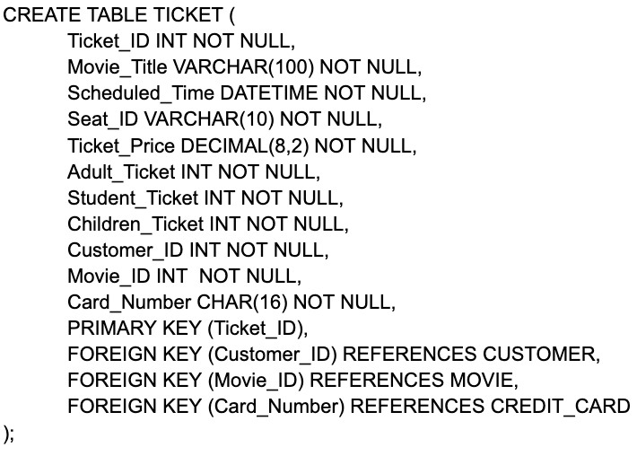
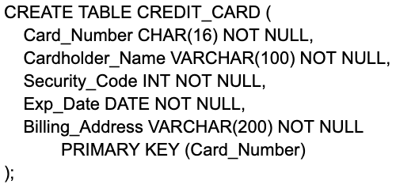
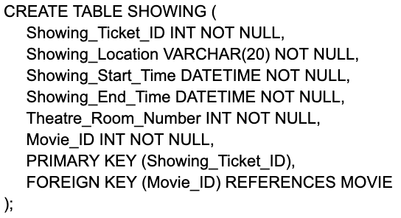
Table Creation
01. CUSTOMER Table
03. MOVIE Table
05. TICKET Table
02. CREDIT_CARD Table
04. SHOWING Table

Slide 14
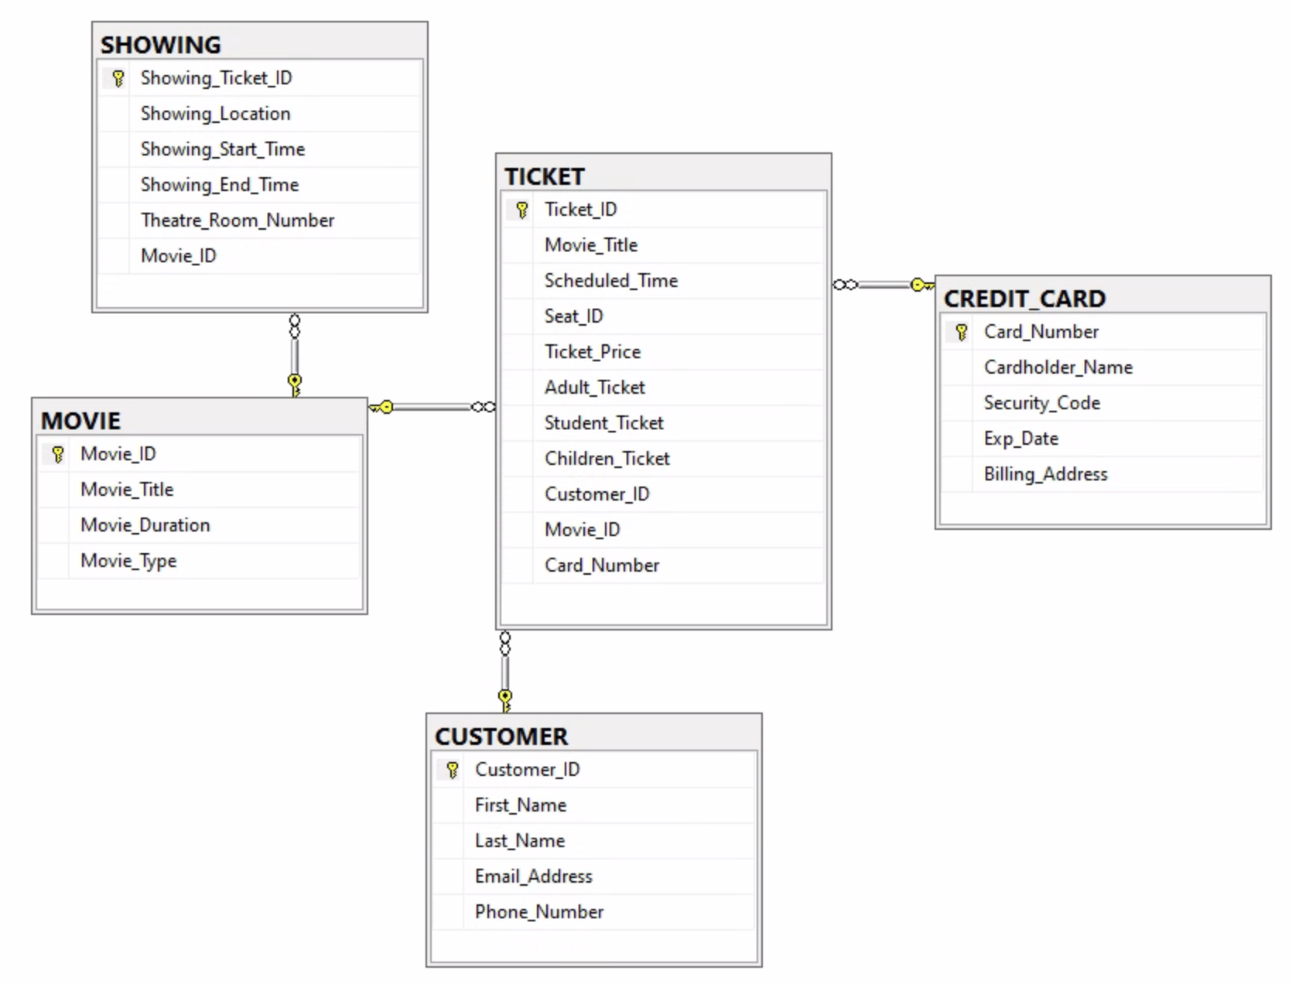
Relational Diagram

Slide 15
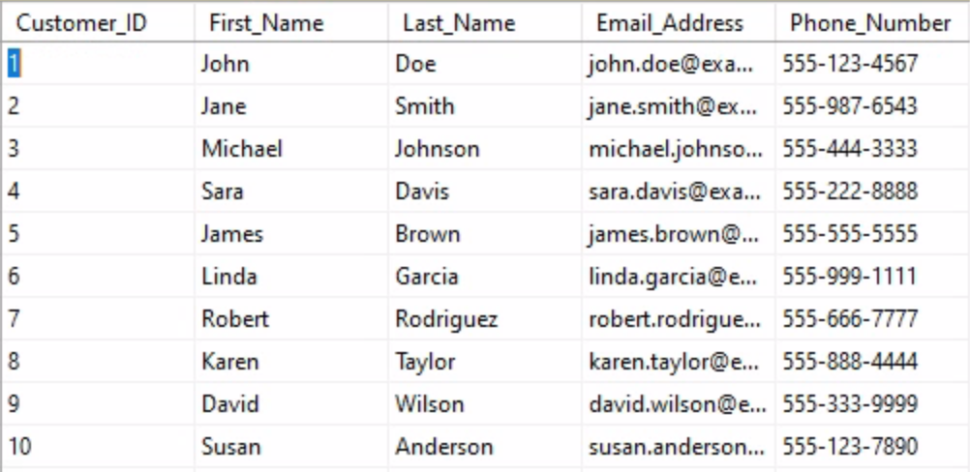
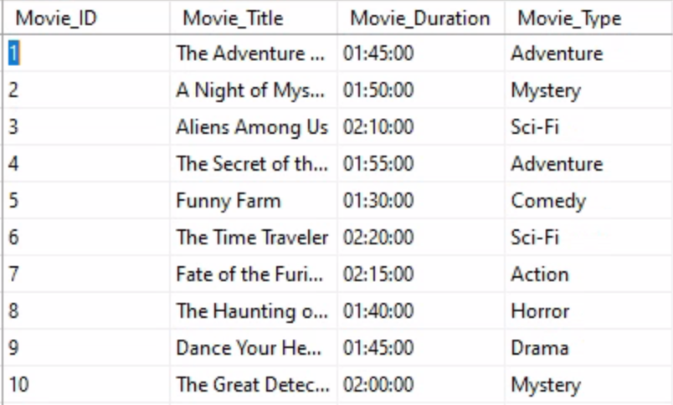
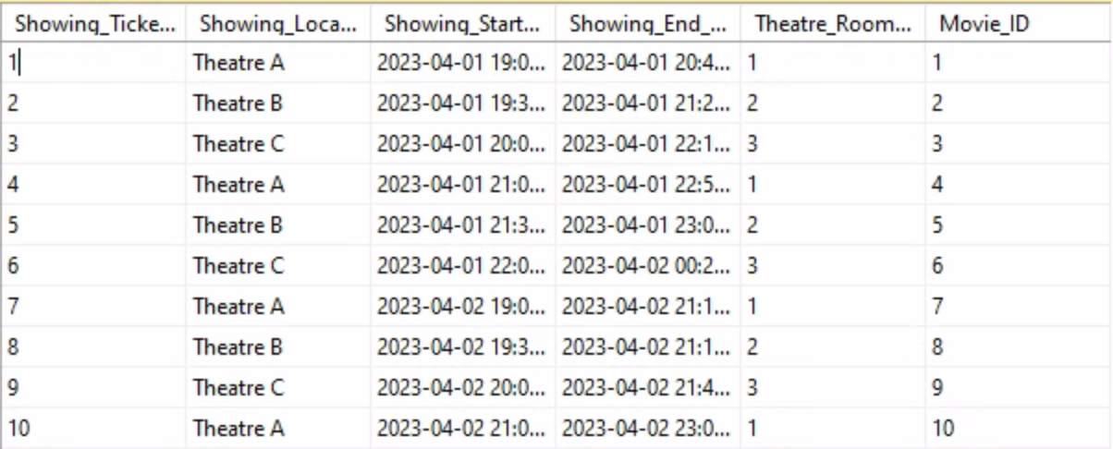
Sample Data
1. Sample Data - CUSTOMER
2. Sample Data - MOVIE
3. Sample Data - SHOWING

Slide 16
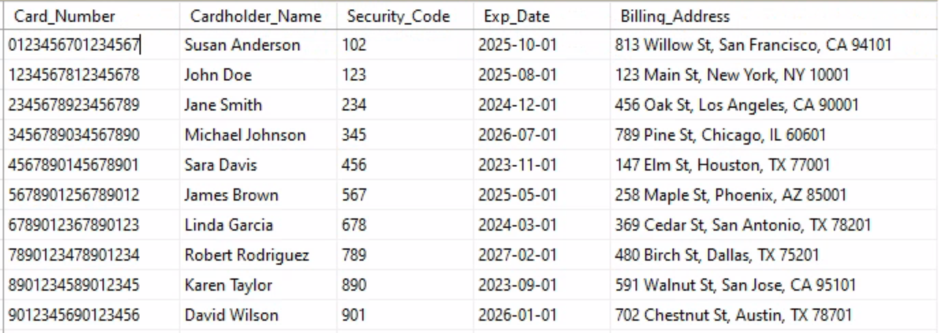
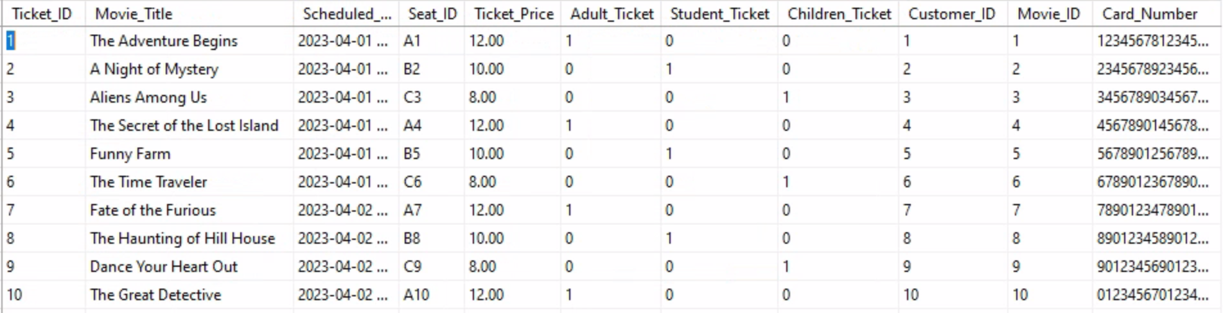
Sample Data
4. Sample Data - CREDIT_CARD
5. Sample Data - TICKET

Slide 17
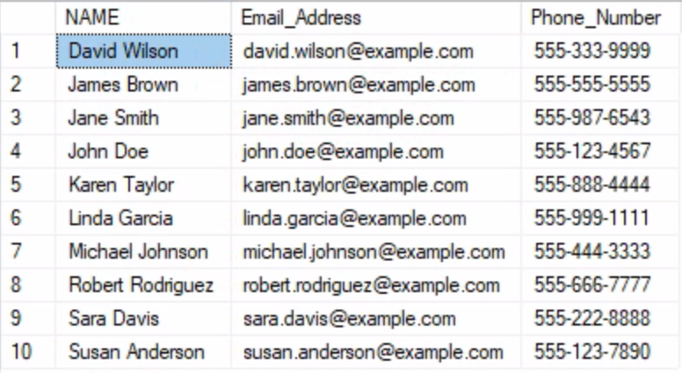
Sample SQL Queries
List customer name, email address, and phone number sorted by name.
Sample Code:
SELECT
DISTINCT CONCAT(First_Name, ' ', Last_Name) AS Name,
Email_Address, Phone_Number
FROM CUSTOMER
ORDER BY Name;
Sample Results:

Slide 18
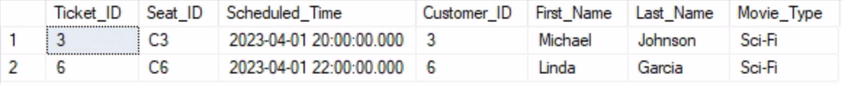
Sample SQL Queries
Get data for customers who watches Sci-Fi movie(Also can be used for seeing how many customers watching a specific movie by changing the Where Condition)
Sample Code:
SELECT
TICKET.Ticket_ID, TICKET.Seat_ID,
TICKET.Scheduled_Time, CUSTOMER.Customer_ID,
CUSTOMER.First_Name, CUSTOMER.Last_Name, MOVIE.Movie_Type
FROM
TICKET
INNER JOIN
CUSTOMER ON TICKET.Customer_ID = CUSTOMER.Customer_ID
INNER JOIN
MOVIE ON TICKET.Movie_ID = MOVIE.Movie_ID
WHERE Movie.Movie_Type='Sci-Fi'
ORDER BY Ticket.Customer_ID
Sample Results:

Slide 19
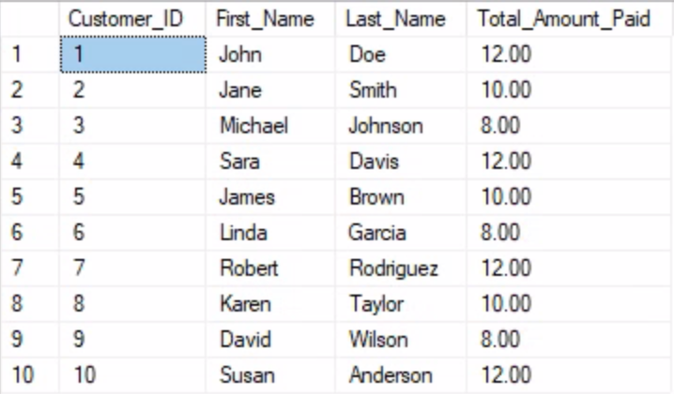

Sample SQL Queries
Get data for a specific customer, find the total amount they paid for their ticket.
Sample Code:
Sample Results:
SELECT
CUSTOMER.Customer_ID,
CUSTOMER.First_Name,
CUSTOMER.Last_Name,
SUM(TICKET.Ticket_Price) AS Total_Amount_Paid
FROM TICKET
INNER JOIN
CUSTOMER ON TICKET.Customer_ID = CUSTOMER.Customer_ID
WHERE CUSTOMER.Customer_ID = 5
GROUP BY
CUSTOMER.Customer_ID,CUSTOMER.First_Name,
CUSTOMER.Last_Name;
By Removing the WHERE condition
Without Removing the WHERE condition

Slide 20
Sample SQL Queries
Get data for customers who watched ‘A Night of Mystery’ on April 1, 2023
Sample Code:
SELECT
CUSTOMER.Customer_ID,
CONCAT(CUSTOMER.First_Name, ' ', CUSTOMER.Last_Name) AS Customer_Name,
TICKET.Scheduled_Time,MOVIE.Movie_Title,SHOWING.Showing_Location,SHOWING.Theatre_Room_Number
FROM TICKET
INNER JOIN CUSTOMER ON TICKET.Customer_ID = CUSTOMER.Customer_ID
INNER JOIN MOVIE ON TICKET.Movie_ID = MOVIE.Movie_ID
INNER JOIN SHOWING ON TICKET.Movie_ID = SHOWING.Movie_ID
WHERE MOVIE.Movie_Title = 'A Night of Mystery'
AND TICKET.Scheduled_Time = '2023-04-01 19:30:00.000'
AND TICKET.Scheduled_Time = SHOWING.Showing_Start_Time
ORDER BY CUSTOMER.Customer_ID;
Sample Results:

Slide 21
Evaluation
& Conclusion

Slide 22
The Achievement
Our functional database is simply for each degree of user to adapt
Clients can through the database to search the movies, movies’ detail, select available seats and purchase the movie tickets online directly.
Our database can search and retrieve information related to the movies, movie showings, customers, tickets, payment informations and so on.

Slide 23
Advantage and Limitation of Microsoft SQL Server
Advantage
Easily scale to meet the demands of growing businesses, allowing us to manage large amounts of data without compromising performance.
Provides robust security features to help protect data, such as encryption, access control, and auditing.
Flexibility of data view and interpretation.
Limitation
Cost will be expensive, especially for larger deployments that require more licenses and hardware.
SQL Server can be complex to configure and manage, requiring skilled database administrators to ensure optimal performance and security.
SQL Server is primarily designed for Windows-based environments and may not work well on other operating systems, limiting its portability to different platforms.

Slide 24
Experience Learned
Learned how to create tables, transform them into relational diagrams on Microsoft SQL.​
Learned how to create sample data and insert data into data tables with following the table constraints.
Learned to design sample queries for extracting data from database on Microsoft SQL.​
Learned how to identify relations and table constraints for integrity control.

Slide 25
CHANGES MADE POST PRESENTATION
CREATION OF A NEW TABLE - TRANSACTION
For Better Processing Situation that a transaction can include multiple tickets
Primary Key: Transaction_ID
Foreign Key: Customer_ID, Card_Number

