Slide 1

PulseSync Tech Marketing Strategy
Healthcare technology startup specializing in wearable heart monitors for real-time cardiac monitoring. Targeting adults 50+ with cardiac conditions, caregivers, and healthcare providers across Ontario.

Slide 2
Project Scope & Objectives
Market Research
Campaign Strategy
Analytics & Pitch
Competitor analysis and target audience insights for healthcare tech market positioning.
Digital marketing approach with email sequences and ad creatives for Ontario pilot launch.
Dashboard development and client presentation with KPIs, budget, and compliance considerations.

Slide 3
Industry Overview
$60B
67%
25%
Market Value by 2030
Remote Monitoring Demand
Annual Growth Rate
Wearable medical device market growth trajectory
Healthcare providers adopting digital solutions
Digital health surge from aging population and telehealth
High competition intensifies as established med-tech companies and startups vie for market share in this rapidly expanding sector.

Slide 4



Target Audience Insights
Primary Segment
Secondary Segment
Tertiary Segment
Adults 50+ with cardiac conditions seeking peace of mind through continuous monitoring
Adult children and spouses managing care for at-risk family members
Healthcare providers integrating remote monitoring into patient care protocols
Digital adoption among 50+ adults has increased 40% since 2020, with growing trust in physician-endorsed health technology solutions.

Slide 5
Competitive Landscape
HeartTrack Inc.
LifeMonitor Co.
PulseSync Advantage
Strategy: App-based ECG monitoring
Strategy: Low-cost devices via pharmacy channels
Real-time cloud synchronization with instant caregiver alerts and comprehensive physician dashboard
Marketing: Webinar series and physician partnerships
Marketing: Traditional retail partnerships
Superior technical architecture creates differentiated user experience
Weakness: Limited caregiver integration
Weakness: Basic cloud functionality

Slide 6
SWOT Analysis
Strengths
Weaknesses
Real-time cloud sync technology
Limited brand recognition
Integrated physician dashboard
Higher price point than competitors
Multi-user caregiver alerts
Small marketing budget
Opportunities
Threats
Rapidly aging Baby Boomer population
FDA regulatory changes
Telehealth adoption acceleration
Tech adoption barriers in 50+ segment
Insurance reimbursement expansion
Well-funded competitor entry

Slide 7

Digital Channel Performance Metrics
Social media engagement rates show strongest performance on Facebook among our target demographic, with LinkedIn driving quality B2B healthcare provider leads.

Slide 8
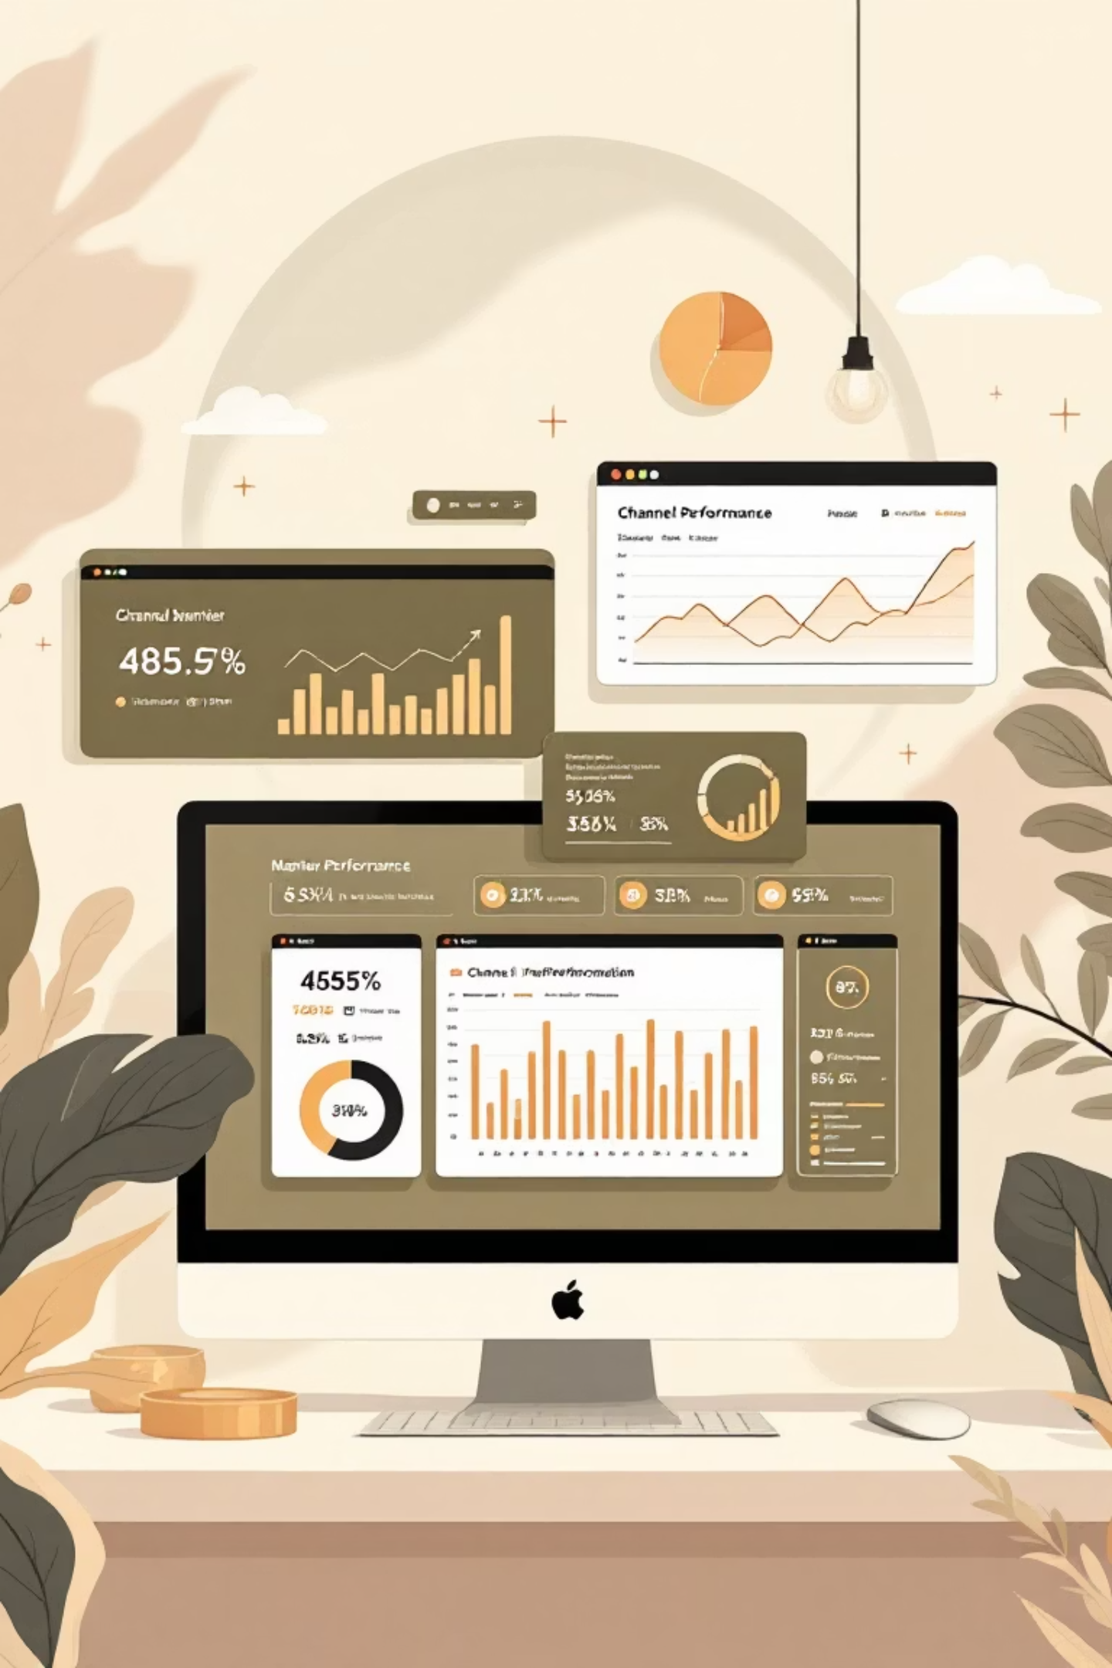
Marketing Channel Performance Review
Campaign insights across Email, LinkedIn Ads, Display Ads, and Webinars over three months

Slide 9

PulseSync Email Campaign Performance
A comprehensive analysis of our 3-stage email funnel strategy for heart health wearable technology, tracking performance from awareness to conversion.

Slide 10



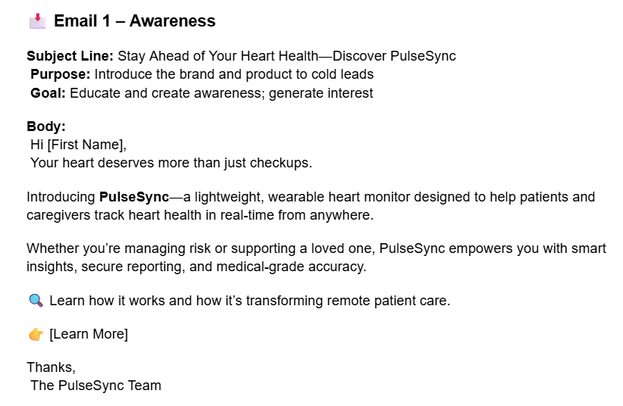
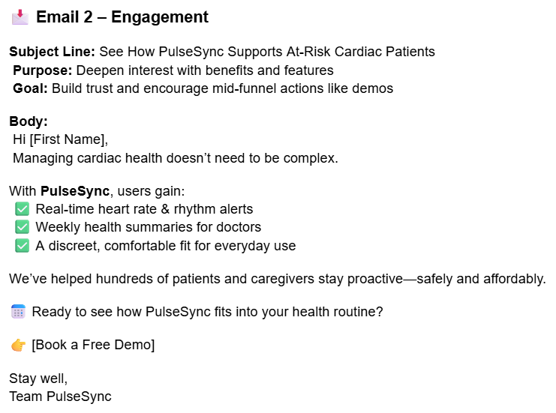
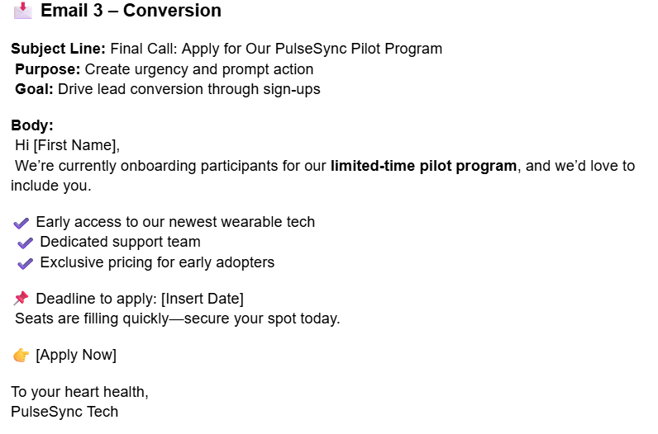



Email Campaign Strategy Overview
Awareness
Engagement
Conversion
Introduce PulseSync brand and product to cold leads. Generate initial interest in heart health monitoring.
Deepen interest with benefits and features. Build trust and encourage demo bookings.
Create urgency with pilot program. Drive lead conversion through limited-time offers.

Slide 11
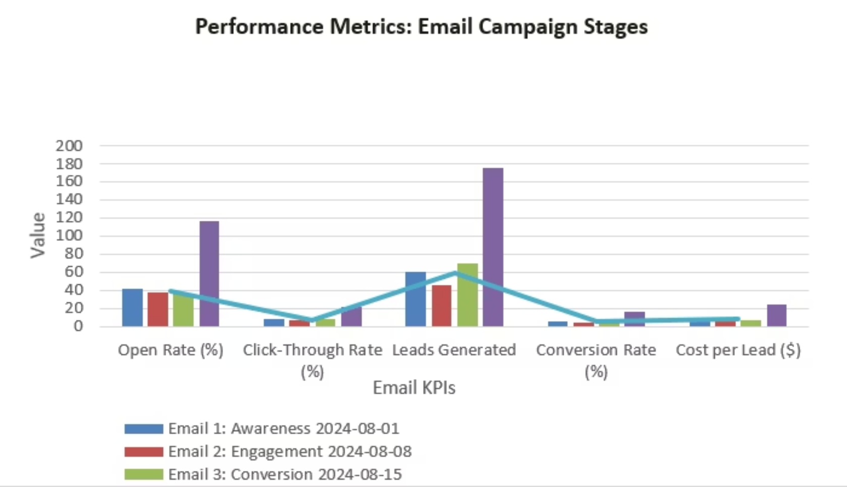
Campaign Performance Results
Key Insights
Top Performer
Email 3 (Conversion) generated 70 leads with lowest cost per lead at $7.14
Strong Opening
Email 1 achieved 42% open rate, indicating excellent subject line and audience targeting
Average cost per lead: $8.19 with clear upward conversion trend through funnel stages.
Optimization Focus
Replicate Email 3 format and A/B test Email 2 subject lines for improved engagement

Slide 12
Executive Summary
Webinars dominate performance
LinkedIn Ads underperform
Email shows potential
Cost-efficient at $11.00 per lead but lowest volume (196 leads)
Highest conversion rate (41.67%), lowest cost per lead ($5.67), and best ROI ($14,400)
Despite 283 leads, highest cost per lead ($24.00) and lowest CTR (1.23%)

Slide 13
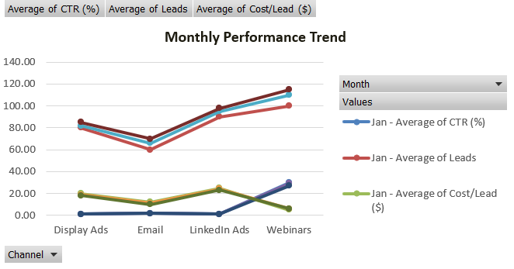
Monthly Trends
January
February
March
Webinars: 100 leads at $5 CPL
Webinars: 110 leads at $6 CPL
Webinars: 115 leads at $6 CPL
LinkedIn: 90 leads at $25 CPL
LinkedIn: 95 leads at $24 CPL
LinkedIn: 98 leads at $23 CPL
1
2
3
“Webinars show consistent growth while maintaining low costs. Email and webinars demonstrate improving cost control.”

Slide 14
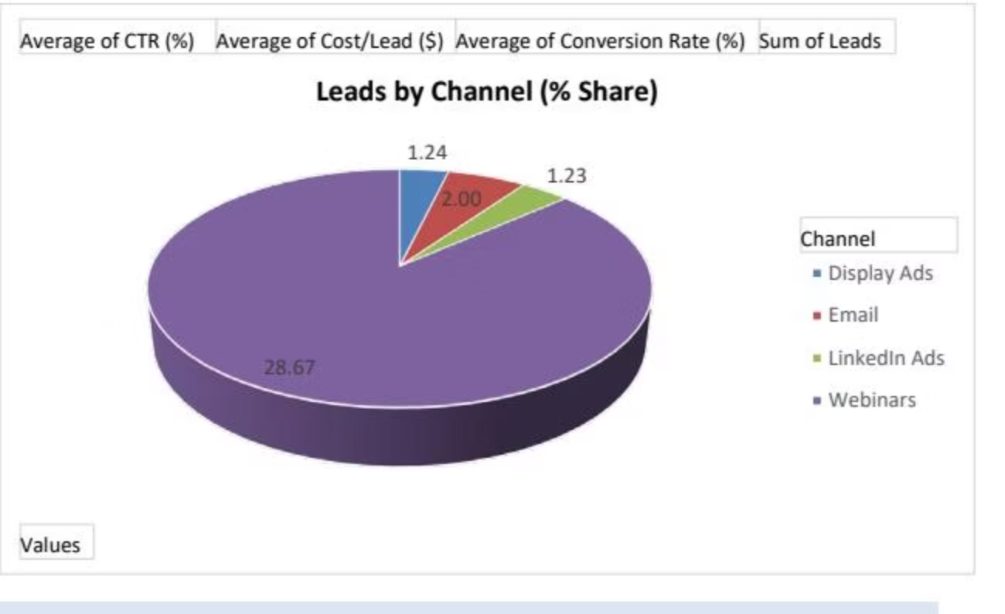
Lead Generation Distribution
325
283
247
196
Webinars
LinkedIn Ads
Display Ads
Email
Highest lead volume
Second in volume
Moderate performance
Lowest volume

Slide 15




Conversion Performance
41.67%
32.00%
Webinars
Email
Best conversion rate
Strong conversion
26.00%
19.67%
Display Ads
LinkedIn Ads
Moderate conversion
Lowest conversion
Webinars convert 135.65 leads total, more than double any other channel

Slide 16
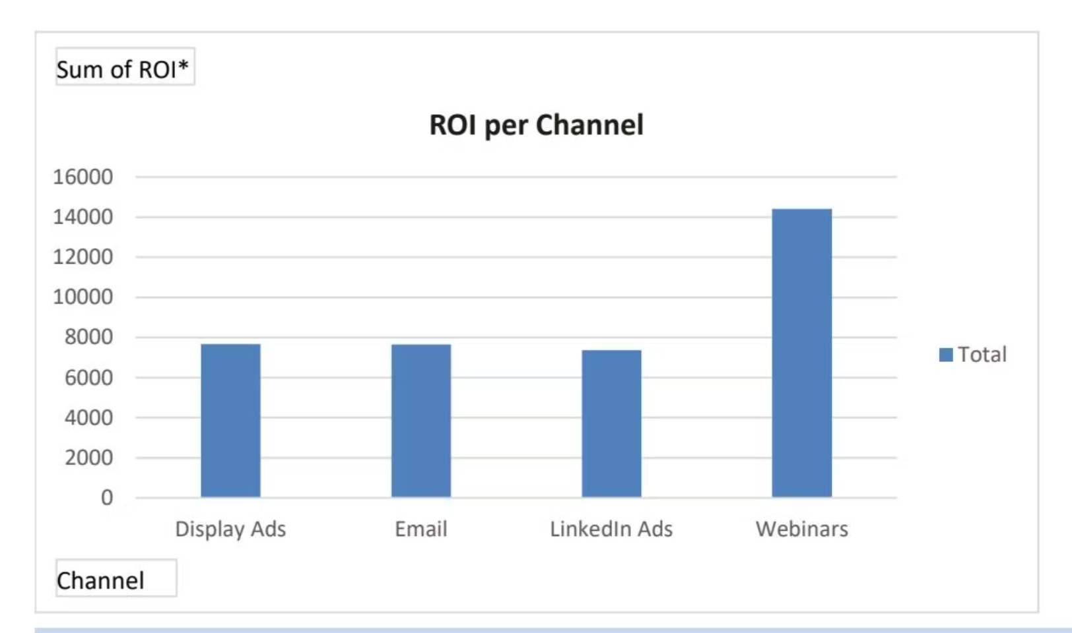
ROI Analysis
Webinars deliver nearly double the ROI of other channels
At $14,400 ROI, webinars significantly outperform Email ($7,654), Display Ads ($7,662), and LinkedIn Ads ($7,366)

Slide 17
Channel Performance Insights
Webinars: Clear Winner
LinkedIn Ads: Needs Optimization
Email: Untapped Potential
Highest CTR (28.67%), lowest cost per lead ($5.67), and most leads generated (325). Exceptional 41.67% conversion rate demonstrates strong audience engagement.
Mid-range cost efficiency ($11 per lead) with strong 32% conversion rate, but lowest lead volume (196). Significant opportunity for scaling.
Poorest efficiency with highest cost per lead ($24) and lowest CTR (1.23%). Despite generating 283 leads, the 19.67% conversion rate suggests targeting issues.

Slide 18




Action Plan
Double down on webinars
Expand reach, scale budget, and A/B test to improve ROI further
Optimize email campaigns
Refine messaging, subject lines, and segmentation to drive more leads
Audit LinkedIn strategy
Evaluate targeting, content relevance, and bid strategies to address high CPL
Monitor trends monthly
Detect CTR dips or CPL increases early and adjust budgets accordingly

Slide 19
Key Takeaways
Webinars are the clear winner
LinkedIn needs reevaluation
Focus on data-driven decisions
High costs and low engagement require strategic overhaul
Superior performance across all KPIs makes them the top priority
Shift strategy toward high-performing channels to enhance ROI
Next steps: Test hybrid strategies combining webinar trust-building with cost-efficient email targeting

