Slide 1

Big Data Medicare Fraud Detection

Slide 2
WHY ?
US Healthcare spending has increased by 6.7 % making it $ 3 trillion.
Medicare accounts for up to $800 bn.
Fraud impact is estimated up to 10%

Slide 3
Workflow
01
Database Selection
CMS Prescriber Data 2017
Payment Data 2017
Excluded (LEIE) dataset
02
Data Pre-processing
Data Visualization/ Exploratory Data Analysis
Data cleaning
Feature Engineering
Class weights Balancing
03
Logistic Regression
Gaussian Naïve Bayes
Random Forest Classifier
Extra Tree Classifier
Gradient Boosting Classifier
Data Modelling
04
End Result
Conclusion
Future scope

Slide 4
Problem Statement
Build an innovative machine learning model that predicts fraud in the Medicare industry using anomaly analysis and geo-demographic metrics.

Slide 5
Fraud Patterns
Fraud by Service Providers (Doctors, hospitals, pharmacies)
Fraud by Insurance subscribers (patient or patient’s employers)
Fraud by insurance carriers
Conspiracy Frauds (involved with all parties)

Slide 6
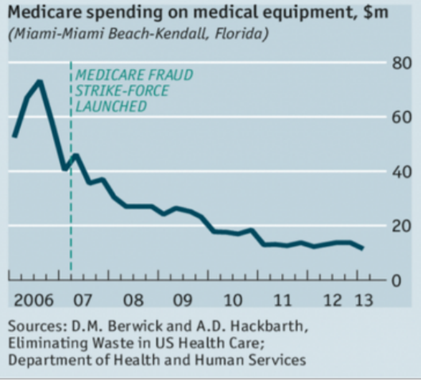
Govt. Efforts
Government has initialized the programs, such as the Medicare Fraud Strike Force, enacted to help combat fraud, but continued efforts are needed to better mitigate the effects of fraud.

Slide 7
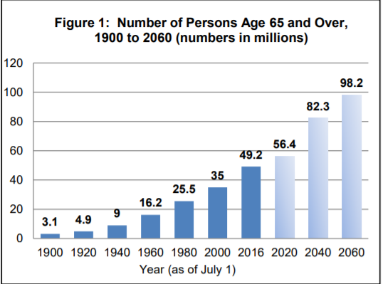
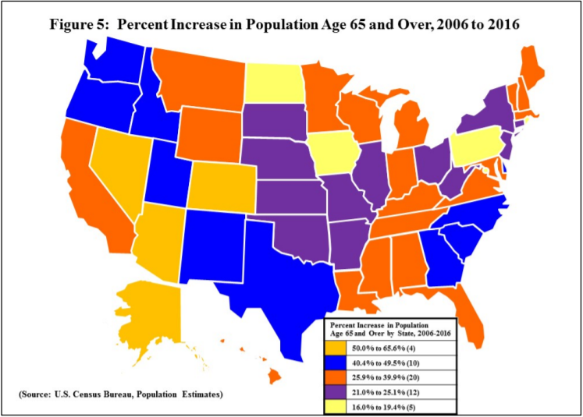

Slide 8
Insights
Tools Used:
Tableau
Power BI
Spark using Azure HDinsight

Slide 9
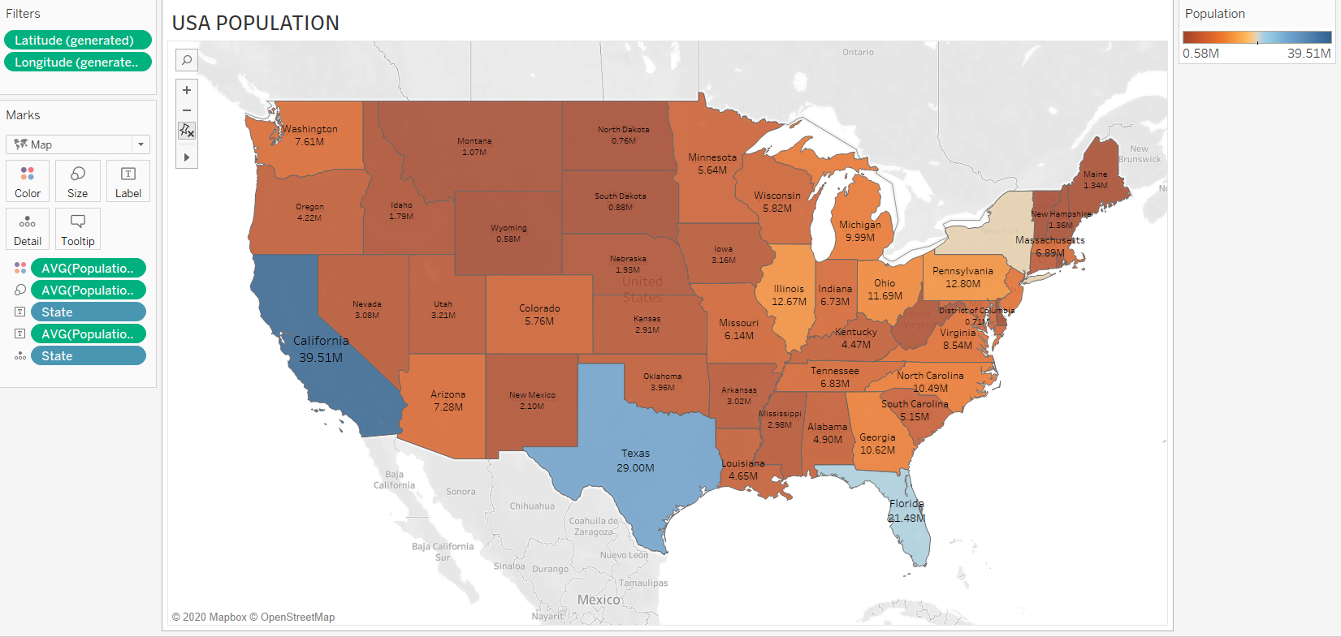
Population by states

Slide 10
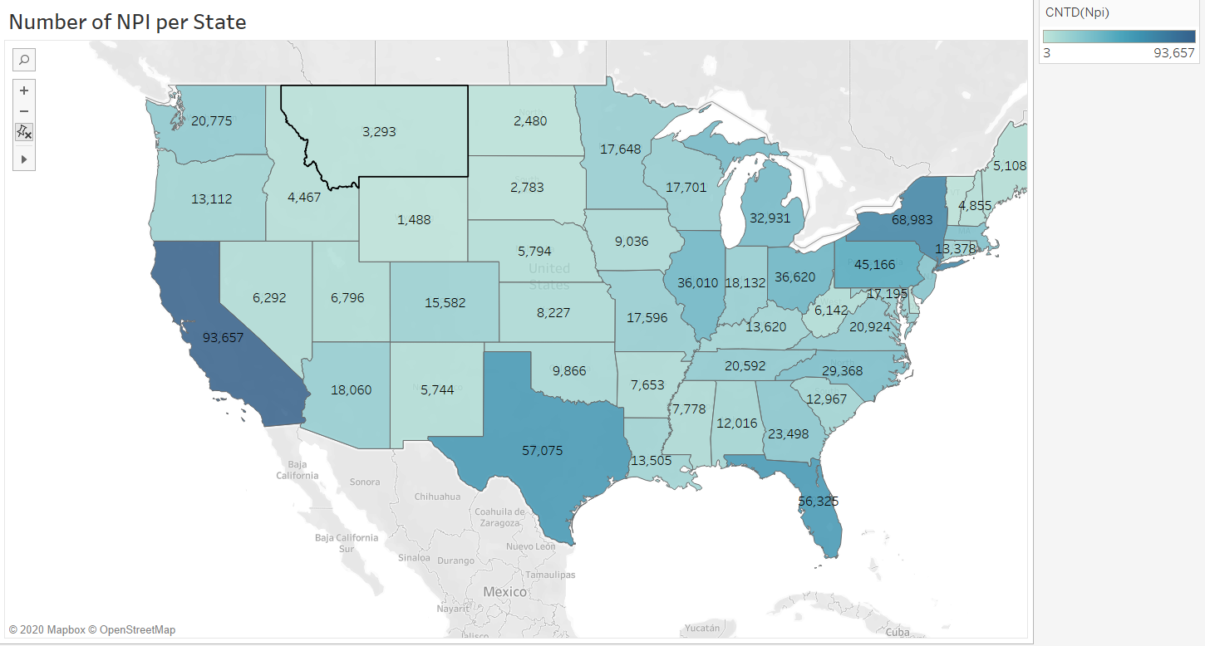
NPI per State

Slide 11
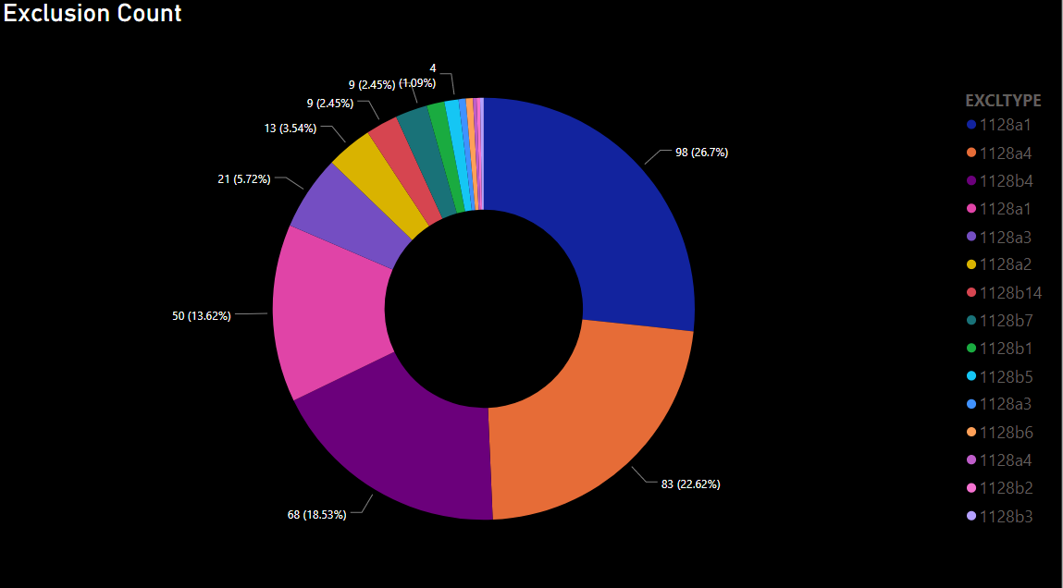
Exclusion Count

Slide 12
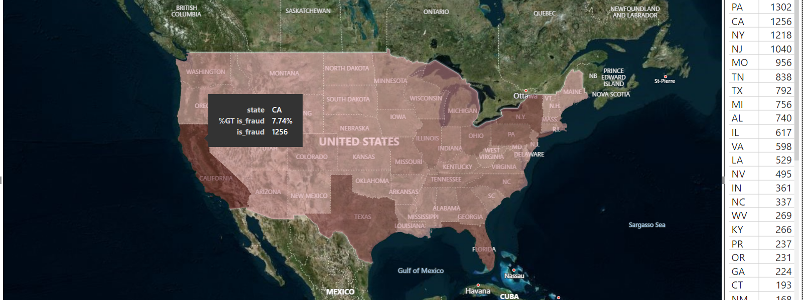
Number of Frauds By state

Slide 13
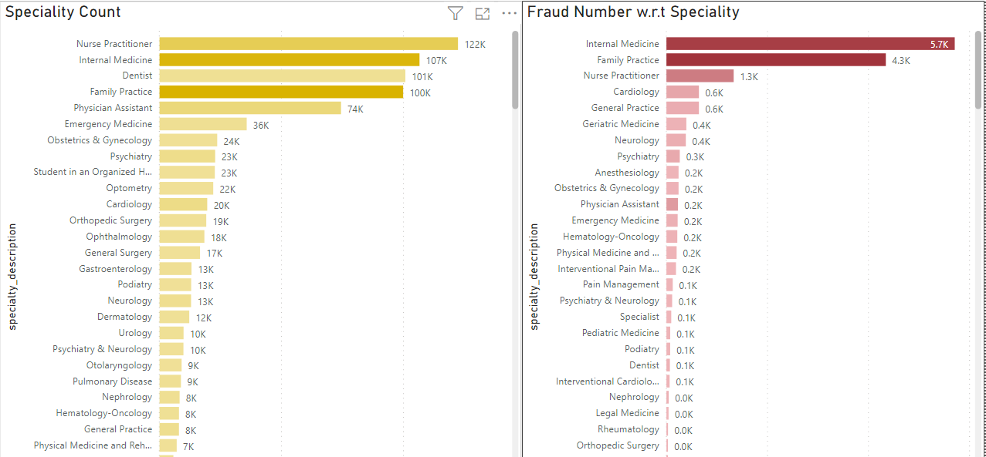

Slide 14
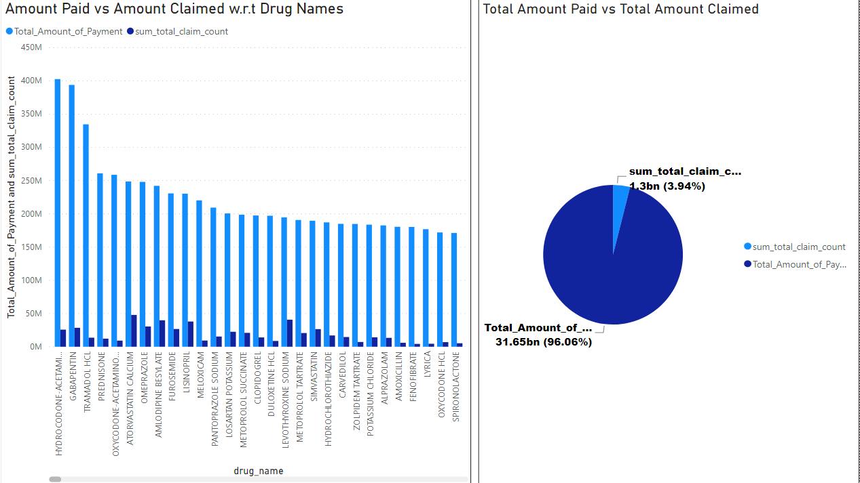

Slide 15


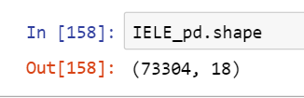
Dataset Selection
01
CMS – Prescriber Data 2017
25M+ rows and 21 columns
All information related to prescription, drugs, payments and charges by National Provider Identifier (NPI).
All information on the physician (NPI, Name, City, Practice, etc.)
02
11M+ rows and 75 columns
Physicians in the US are required to declare all payments received from pharmaceutical companies
The sum of general payment
Name of drug associated with the payments
Payments Received by Physicians 2017
03
list of individuals and entities that are excluded from participating in federally funded healthcare programs (i.e. Medicare) due to previous healthcare fraud.
Mapped fraud labels
List of Excluded Individuals and Entities (LEIE) database 2017

Slide 16

Data Pre-Processing
Data cleaning
Impute missing Data
Removing duplicates
Removing outliers
Factoring the categorical data
Removing data based on general information.
Data Sampling: The data set is very imbalanced in terms of fraud detection context as it is very skewed (99 % no fraudulent cases and less than 1% fraudulent cases)

Slide 17
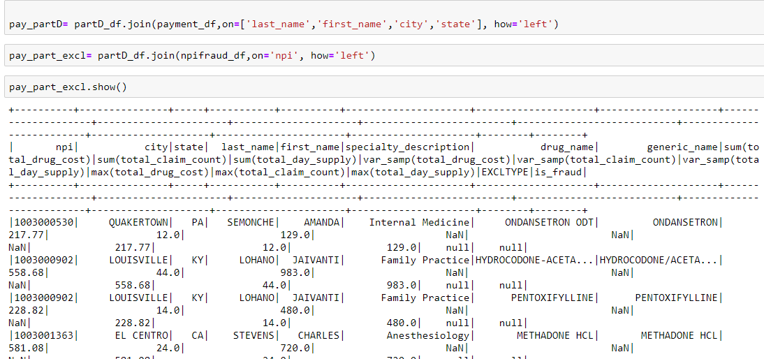
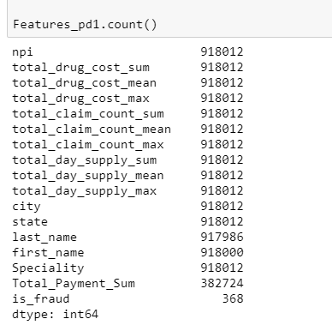
Feature Engineering
Joining datasets based on NPI, state, city, first and last name.

Slide 18

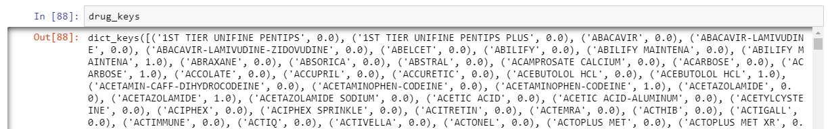
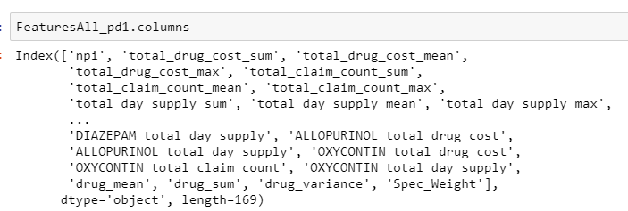
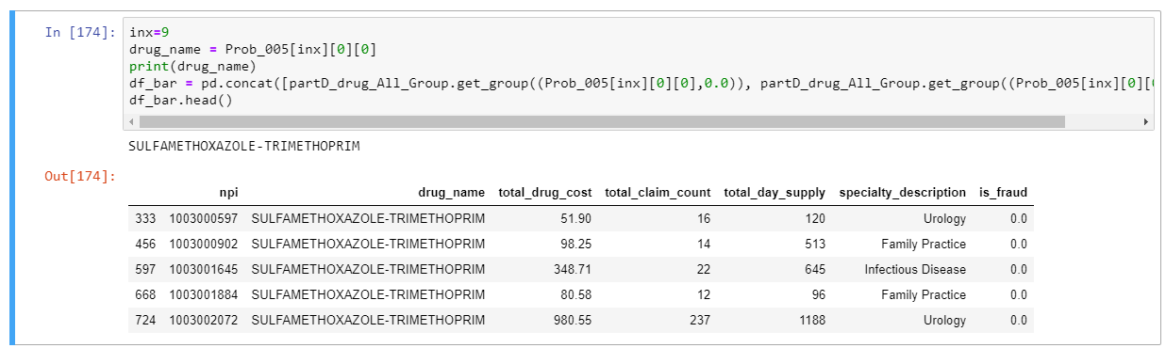
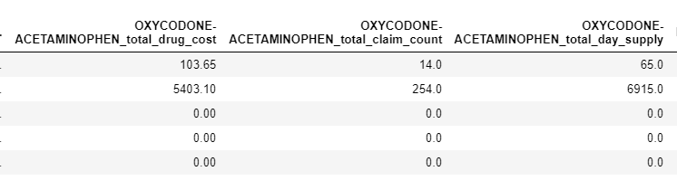
Drug- based Fraudulent cases
Merging drug fraudulent cases with prescriber data to create more features

Slide 19
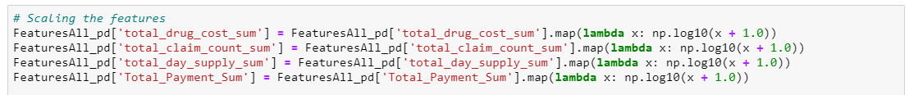
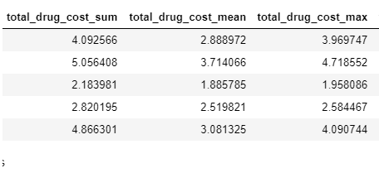
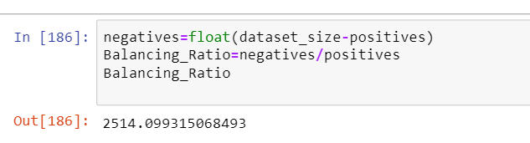
Transforming Data and class balancing
Transform skewed data to approximately conform to normality by using log transformation
Class weights assigned to reduce skewness according to the balancing ratio

Slide 20
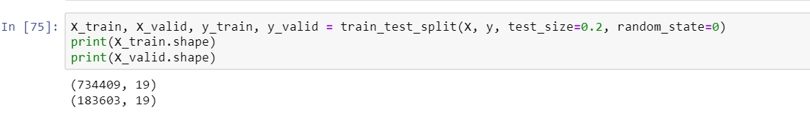
Data Modelling
ExtraTrees
Models Implemented:
Logistic Regression
Gaussian Naïve Bayes
and Gradient Boosting
Classifier
Train-Test-Split
Scaling data using Standard Scalar

Slide 21
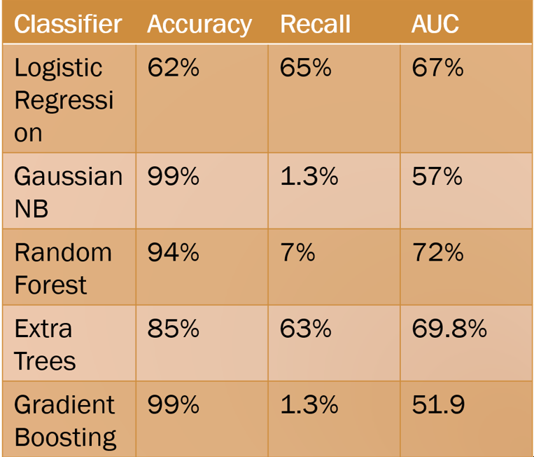
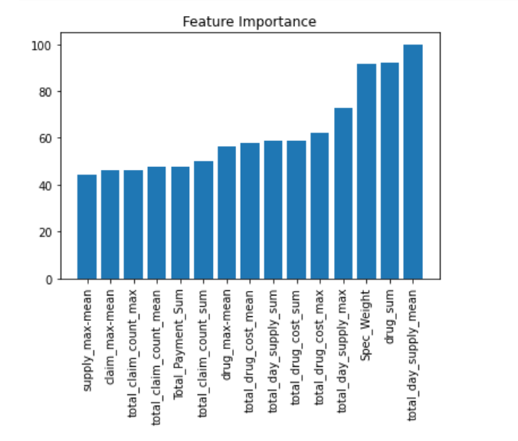
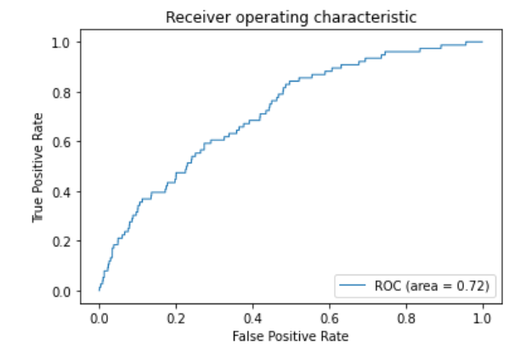
Model Evaluation
Random Classifier

Slide 22
Conclusion
With the increasing number of population of over 65 in USA, Medicare Fraud Detection is essential
All types of Fraud Patterns have been Covered.
Most Fraud Cases committed are in bay area
Out of 5 Models Performed, best resulting model is Random Forest with AUC 72 %

Slide 23
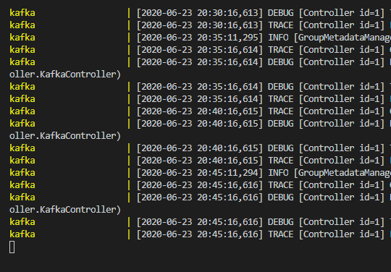
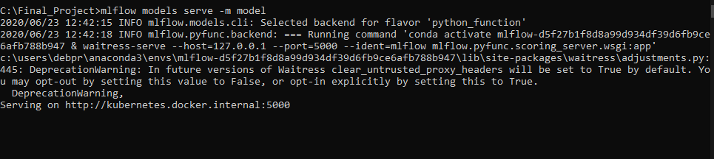
Future Scope
Use cross validation for sampling the data into train-test split.
Hyper-parameter tuning to increase the overall performance of the algorithm.
Build a real-time fraud detection pipeline using ML flow and Kafka.
The model needs to be retrained without stopping the prediction service, since users will keep interacting.
Kafka and zookeeper server initialized using docker
Random Forest Model hosted using ML flow

Slide 24
References
Part D Prescriber Data CY 2017. (n.d.). Retrieved June 23, 2020, from https://www.cms.gov/Research-Statistics-Data-and-Systems/Statistics-Trends-and-Reports/Medicare-Provider-Charge-Data/PartD2017
LEIE Downloadable Databases: Office of Inspector General: U.S. Department of Health and Human Services. (2020, June 10). Retrieved June 23, 2020, from https://oig.hhs.gov/exclusions/exclusions_list.asp
Dataset Downloads. (n.d.). Retrieved June 23, 2020, from https://www.cms.gov/OpenPayments/Explore-the-Data/Dataset-Downloads

Slide 25

Thank you

